Slide 1
GRAMENER CASE STUDY
Group Members:
Vijayanand Narayanan
Jayanti Tripathi
Shriram Venkat Peddhibhotla
Devesh Joshi

Slide 2
Abstract
Business Problem
Company faces a risk of losing money by lending to risky loan applicants
Company may lose business if loan is not granted to an individual who is able to repay the loan
How to minimise risk of losing money while lending money to customers
Objectives
Carry out research in risk analytics and conduct analysis using data from previous loan applicants to,
Understand the consumer and loan attributes that influence the tendency to default
Identify driving factors behind loan default
Identify borrowers who are capable of defaulting on their loans
Identify risky loan applicants
Reduce credit loss to company by not lending loans to risky applicants

Slide 3
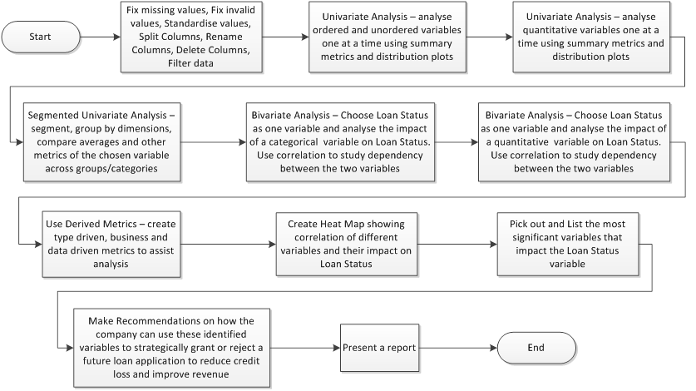
Problem Solving Methodology

Slide 4
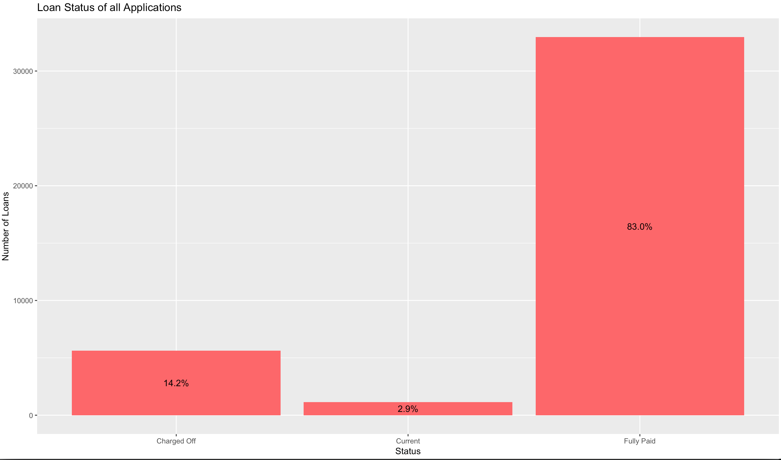
Univariate Analysis – Loan Status
83% of the total loans were Fully Paid by customers.
14.2% of total customers defaulted on their loans.

Slide 5
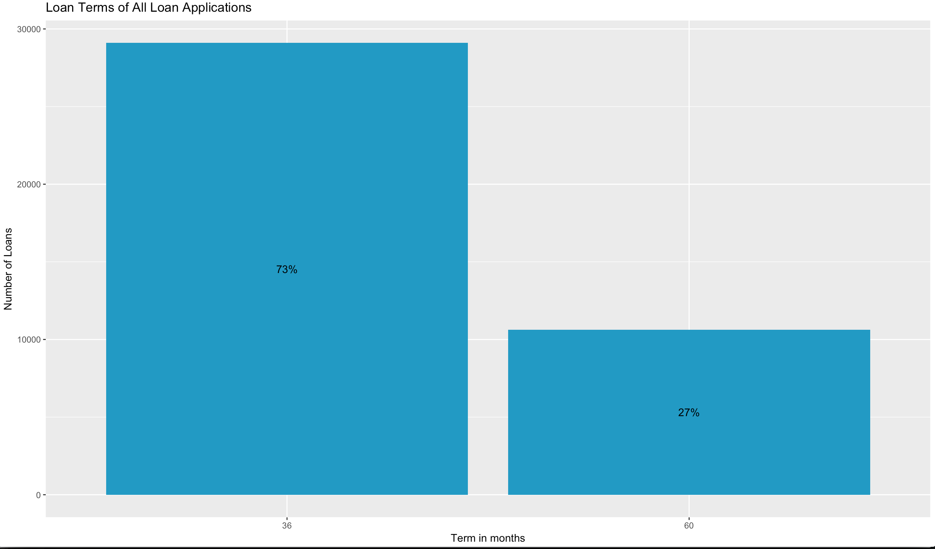
Univariate Analysis – Loan Term
73% of people chose a loan term of 3 years i.e 36 months
27% of people chose a long term loan of 5 years ie 60 months

Slide 6
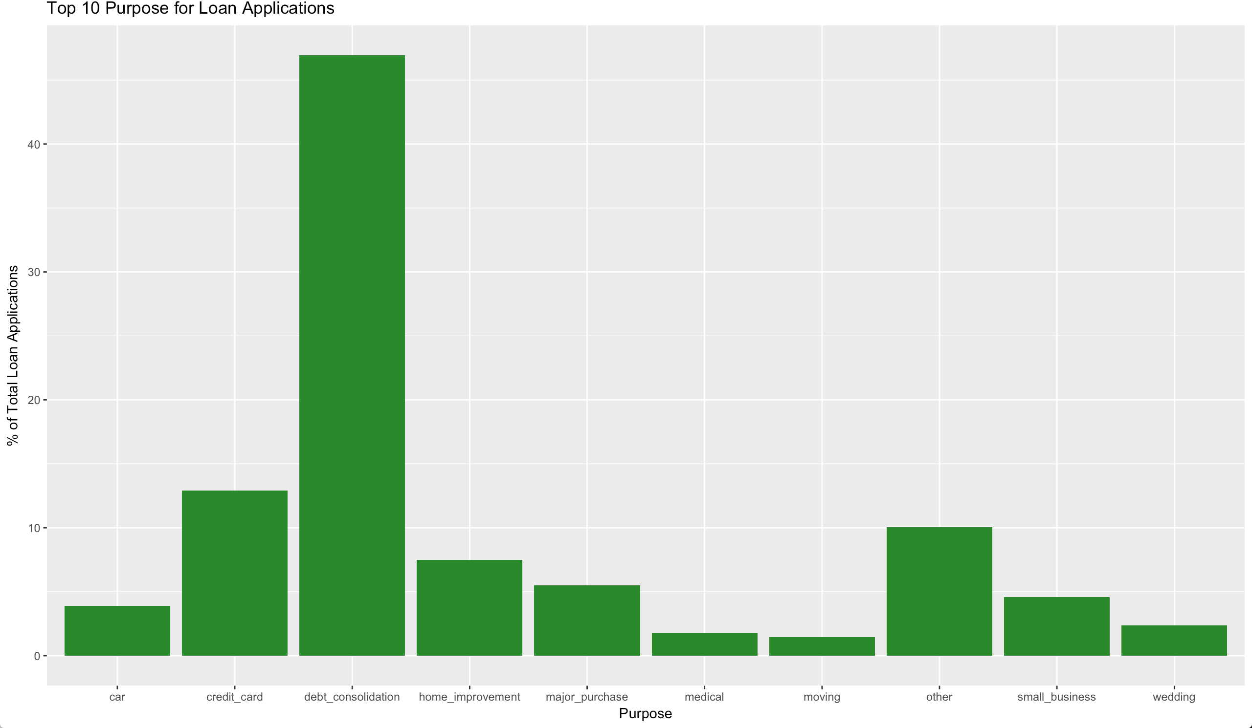
Univariate Analysis – Loan Purpose
47% of people applied for a loan for the purpose of Debt Consolidation
13% of people applied for a loan for the purpose of Credit Card
Other popular reasons include Home Improvement, Major Purchase, Small Business, Car, Wedding, Medical and Moving

Slide 7
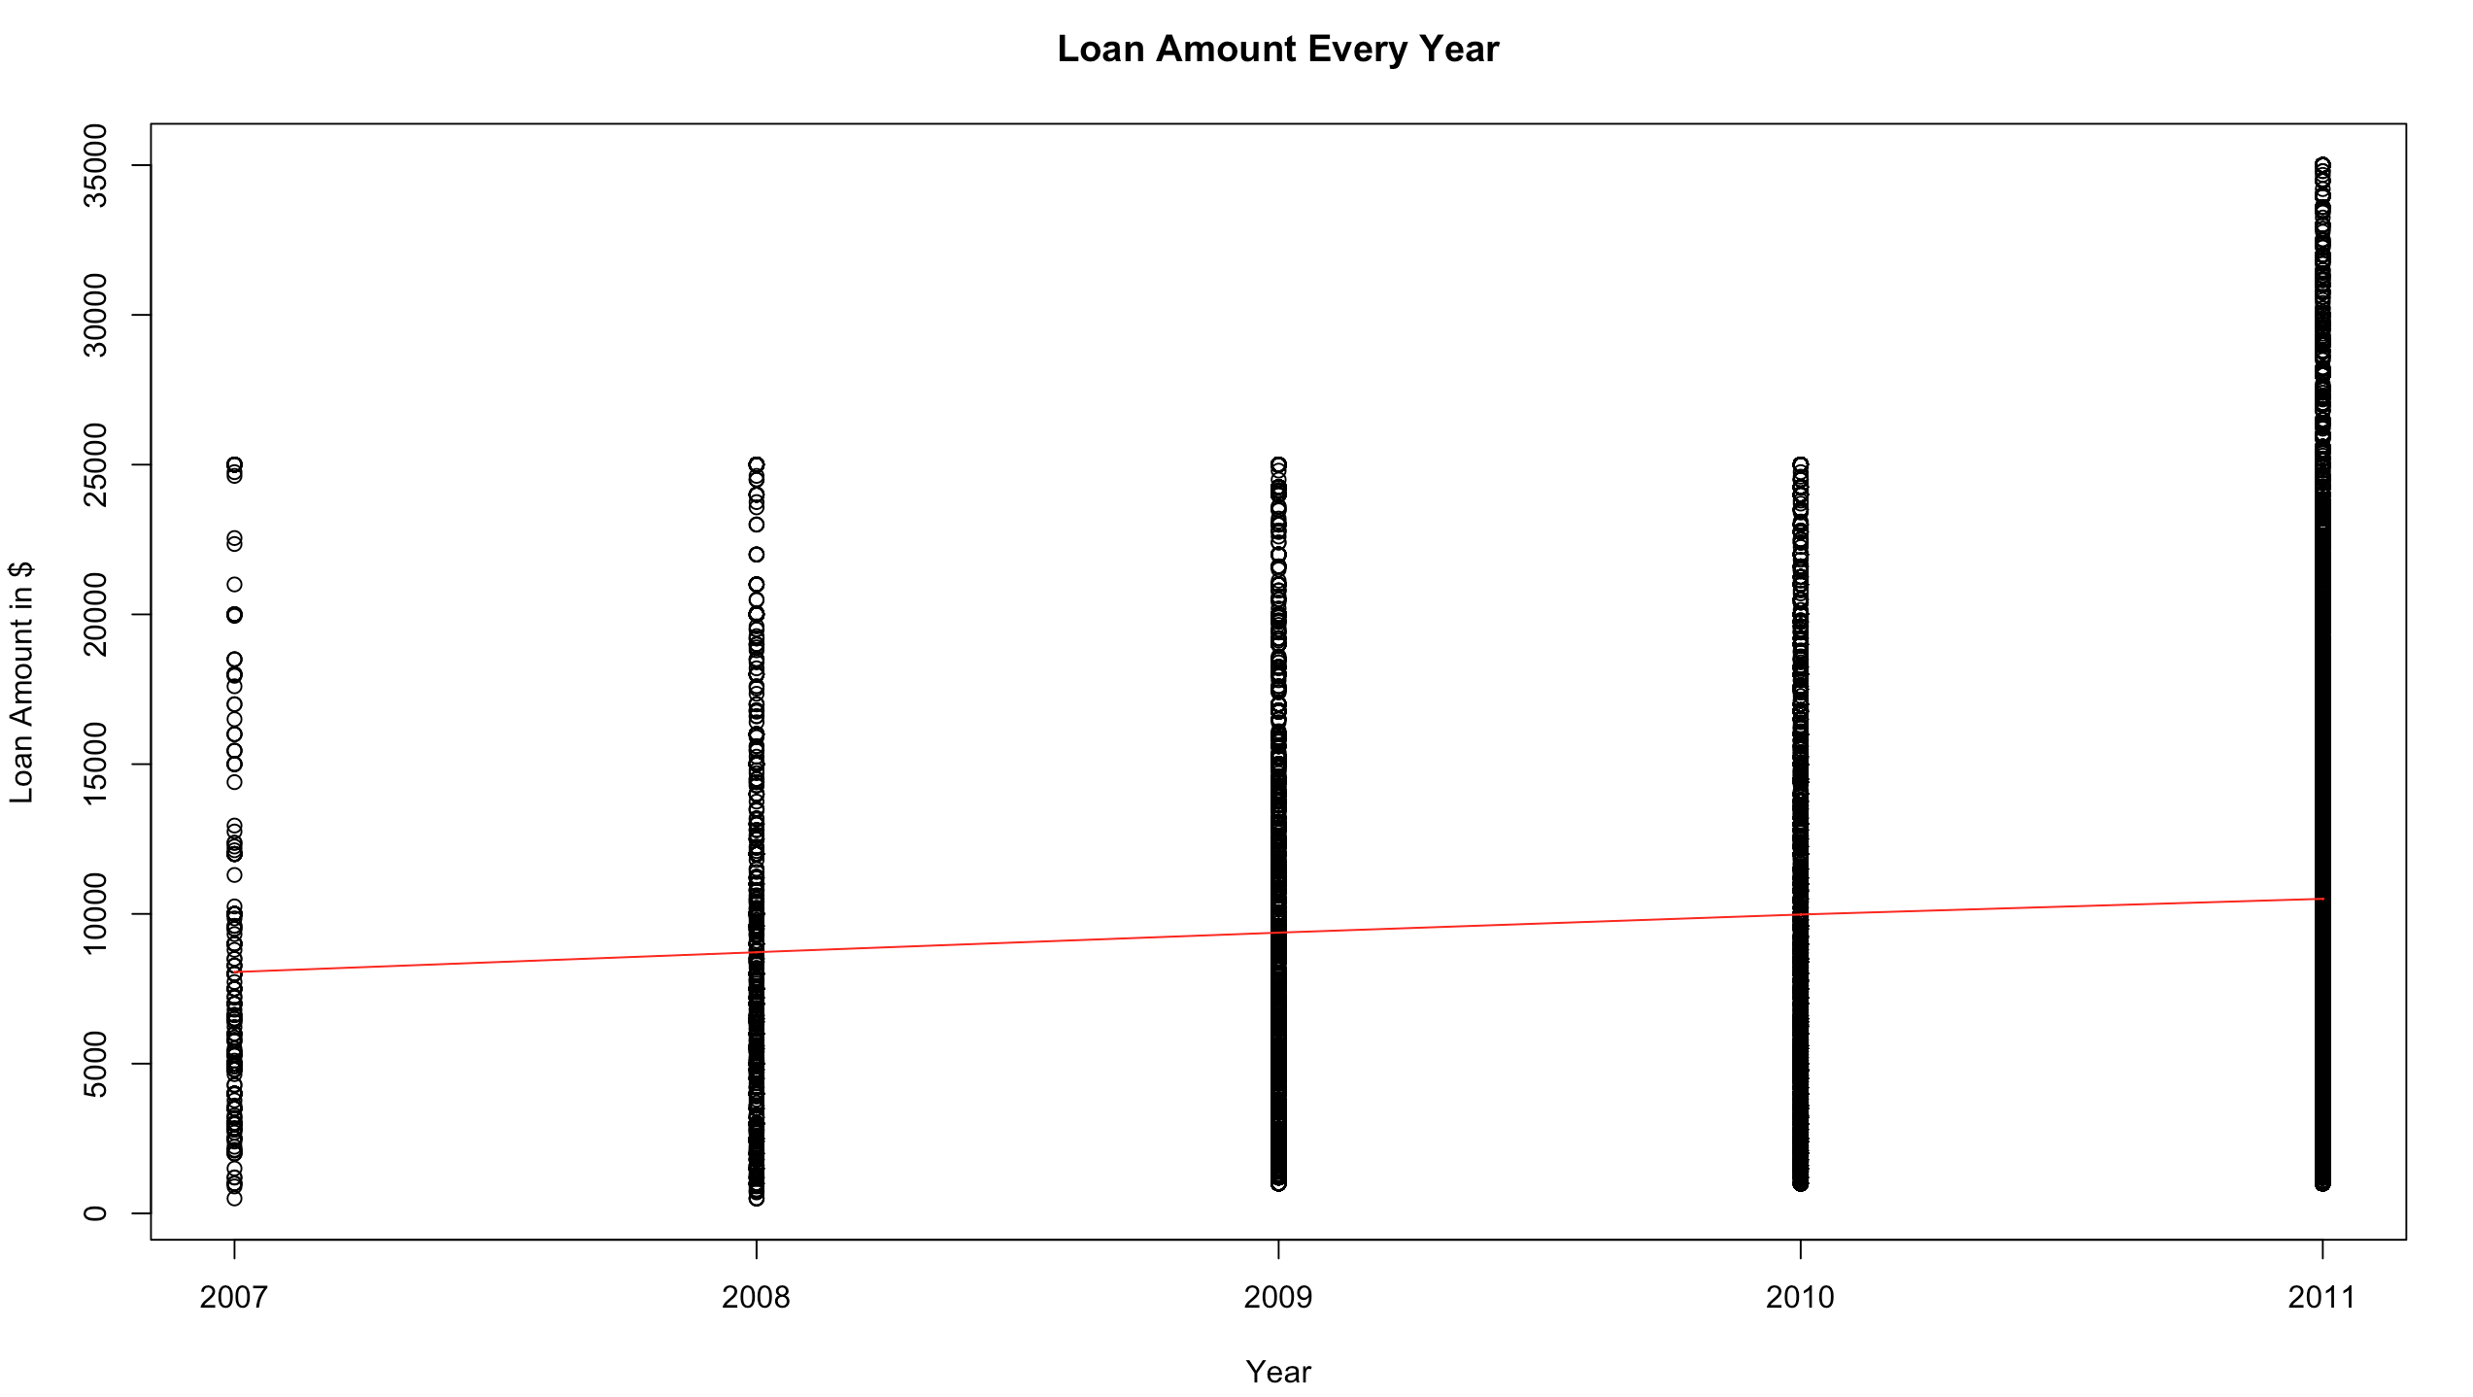
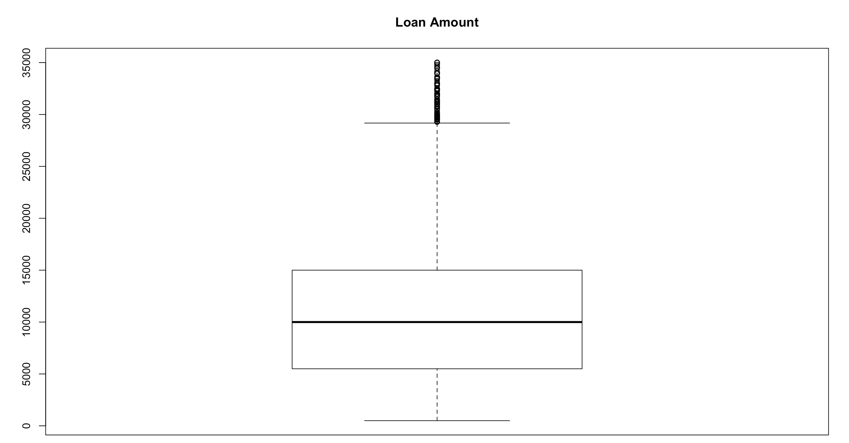
Univariate Analysis – Loan Amount
Average loan amount is $10000
Average Loan amount has been increasing each year and shows a steady positive trend

Slide 8
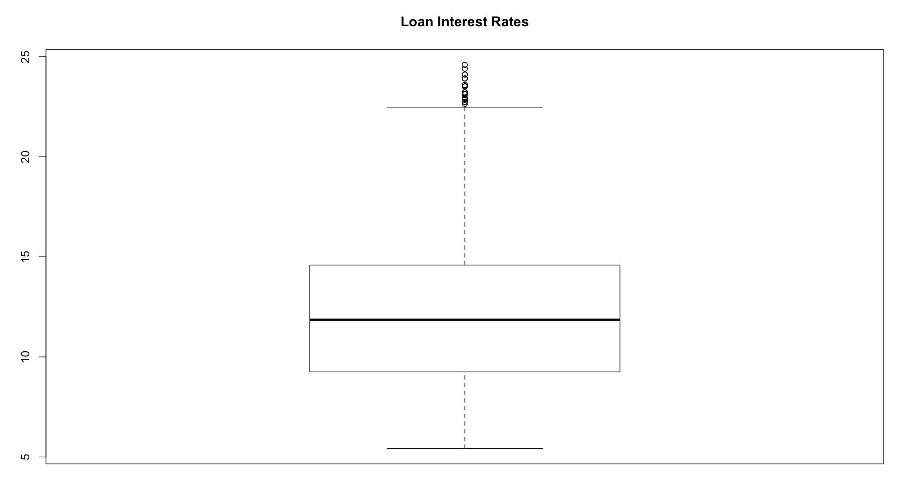
Univariate Analysis – Loan Interest Rate
Average interest rate for a loan is 12%
There are 9832 customers out of a total 39717 who have loans with interest rate in excess of 14.6
Nearly 25% of loans have a high interest rate

Slide 9
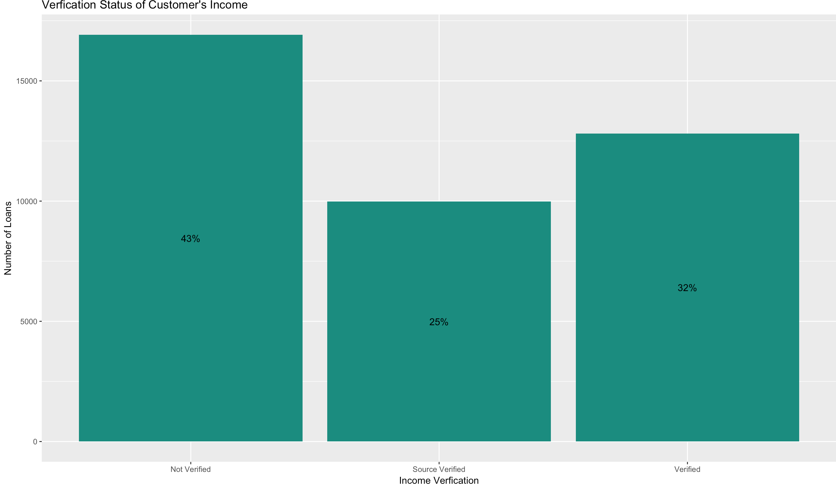
Univariate Analysis – Verification Status
43% of loans did not have either the customer's income or its source verified
25% of loans had both the customer’s income and its source verified
32% of loans had the customer’s income verified but not its source

Slide 10
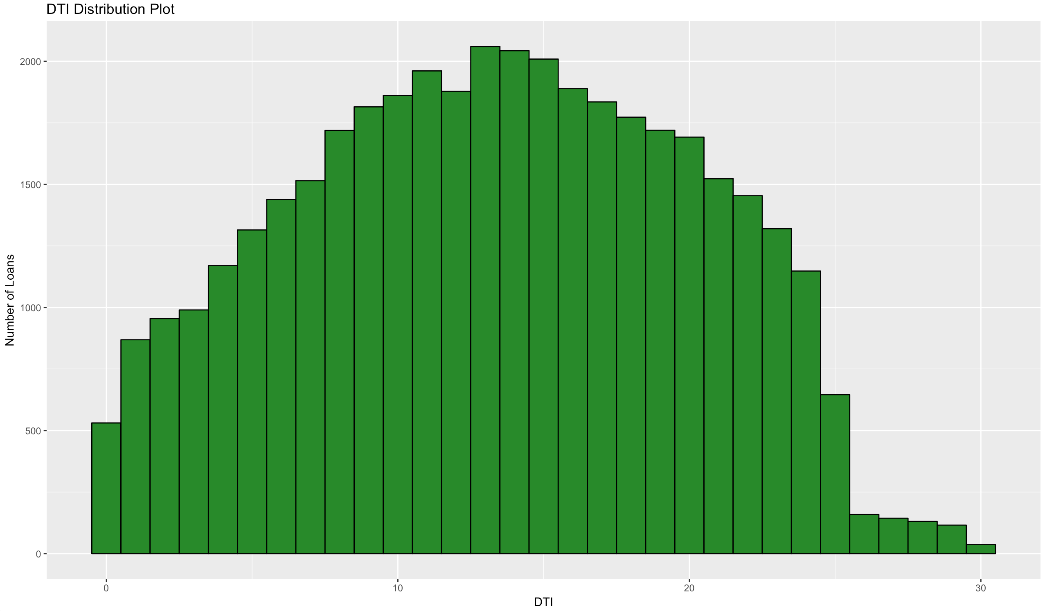
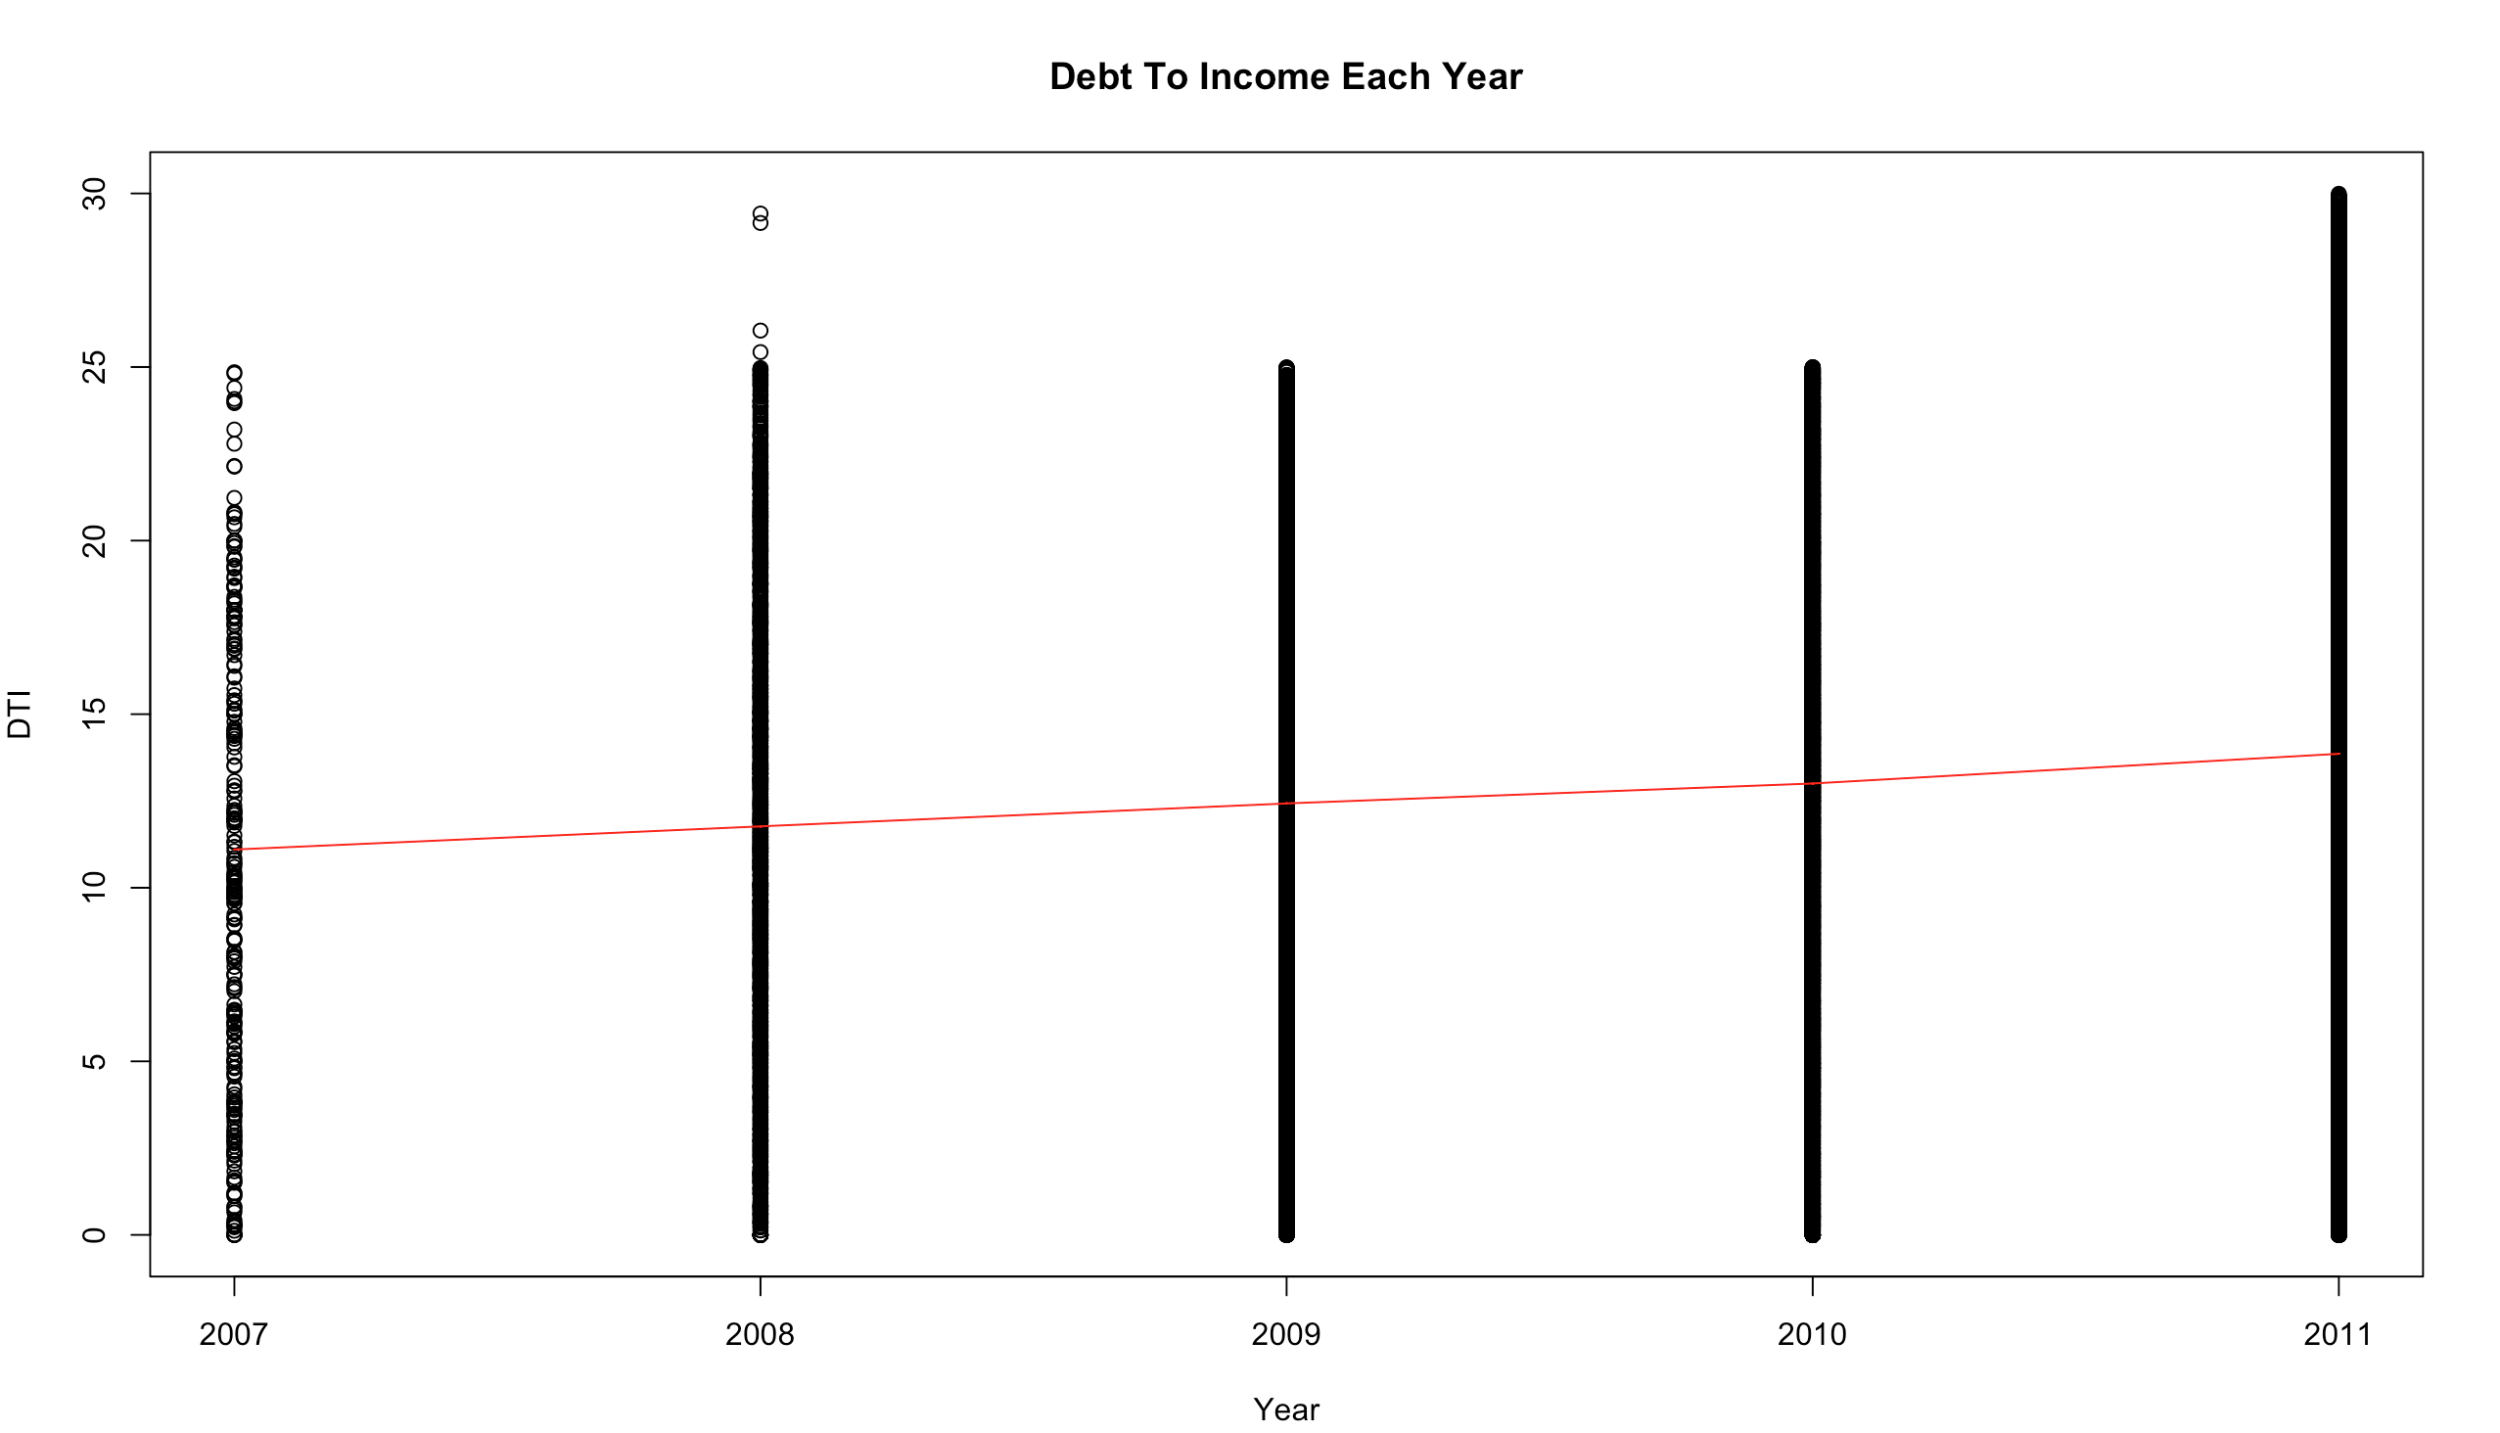
Univariate Analysis – Debt To Income
Average DTI of loan applicants was 13
Debt in the population is growing as there is a steady increase in DTI every year

Slide 11
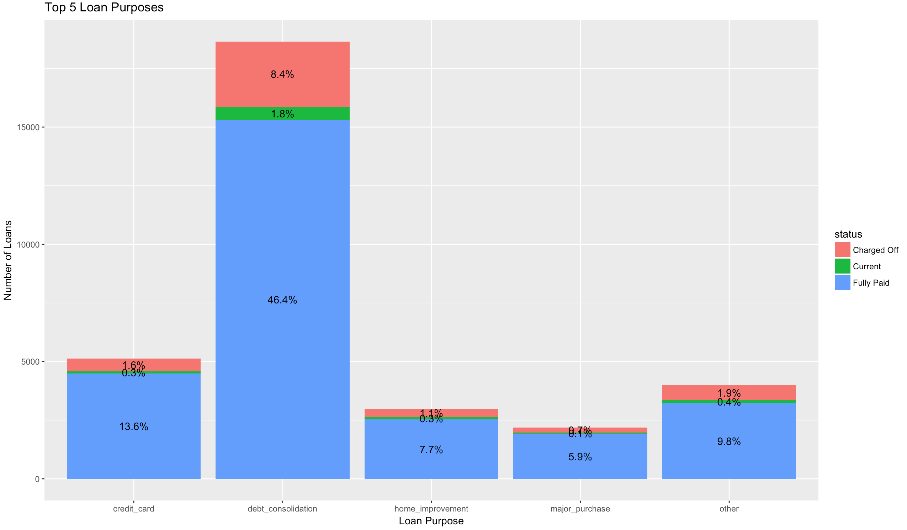
Bivariate Analysis – Purpose vis-à-vis Status
57% of people borrowed loan for debt consolidation and 8% of those defaulted on their loans
Highest defaulters were when the purpose for loan was Debt Consolidation
A total of 10% people defaulted when purpose for loan was either debt consolidation or credit cards

Slide 12
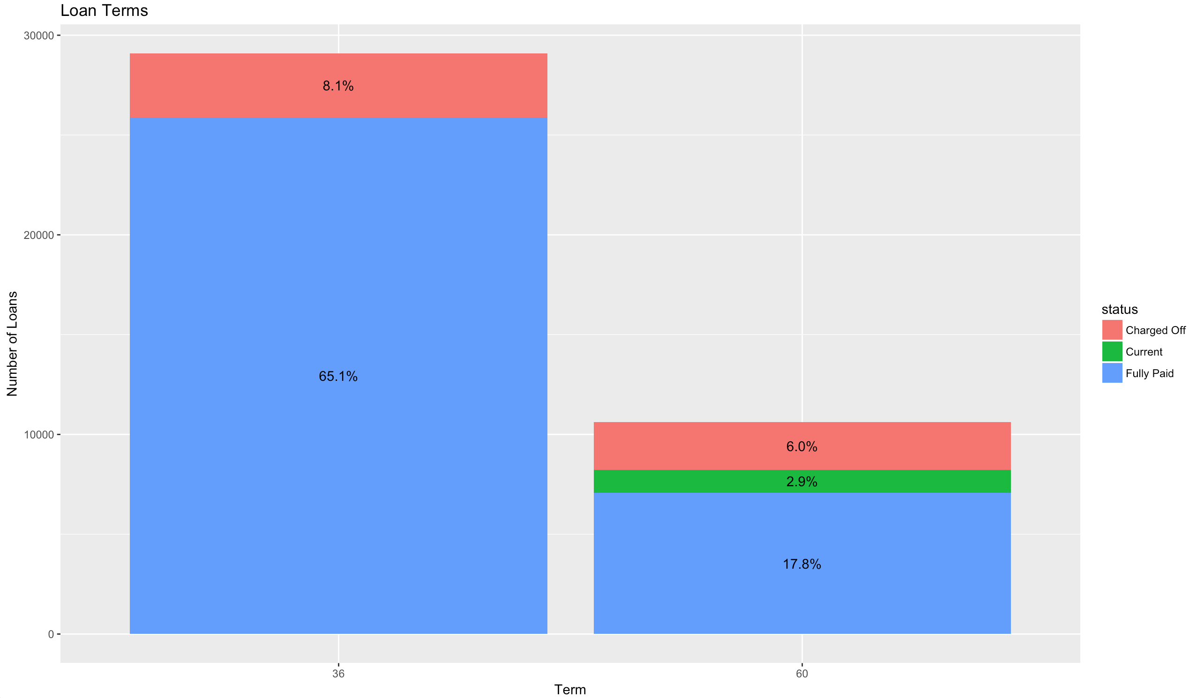
Bivariate Analysis – Term vis-à-vis Status
73% of applicants applied for a 3 year loan compared to 27% people who required a 5 year loan
8.1% of people defaulted when loan term was 36 months and 6% of people defaulted when it was 60 months
If loan term in months increases there is a tendency for customers to default on their loans
Customers on a longer duration loan term tend to be more risky

Slide 13
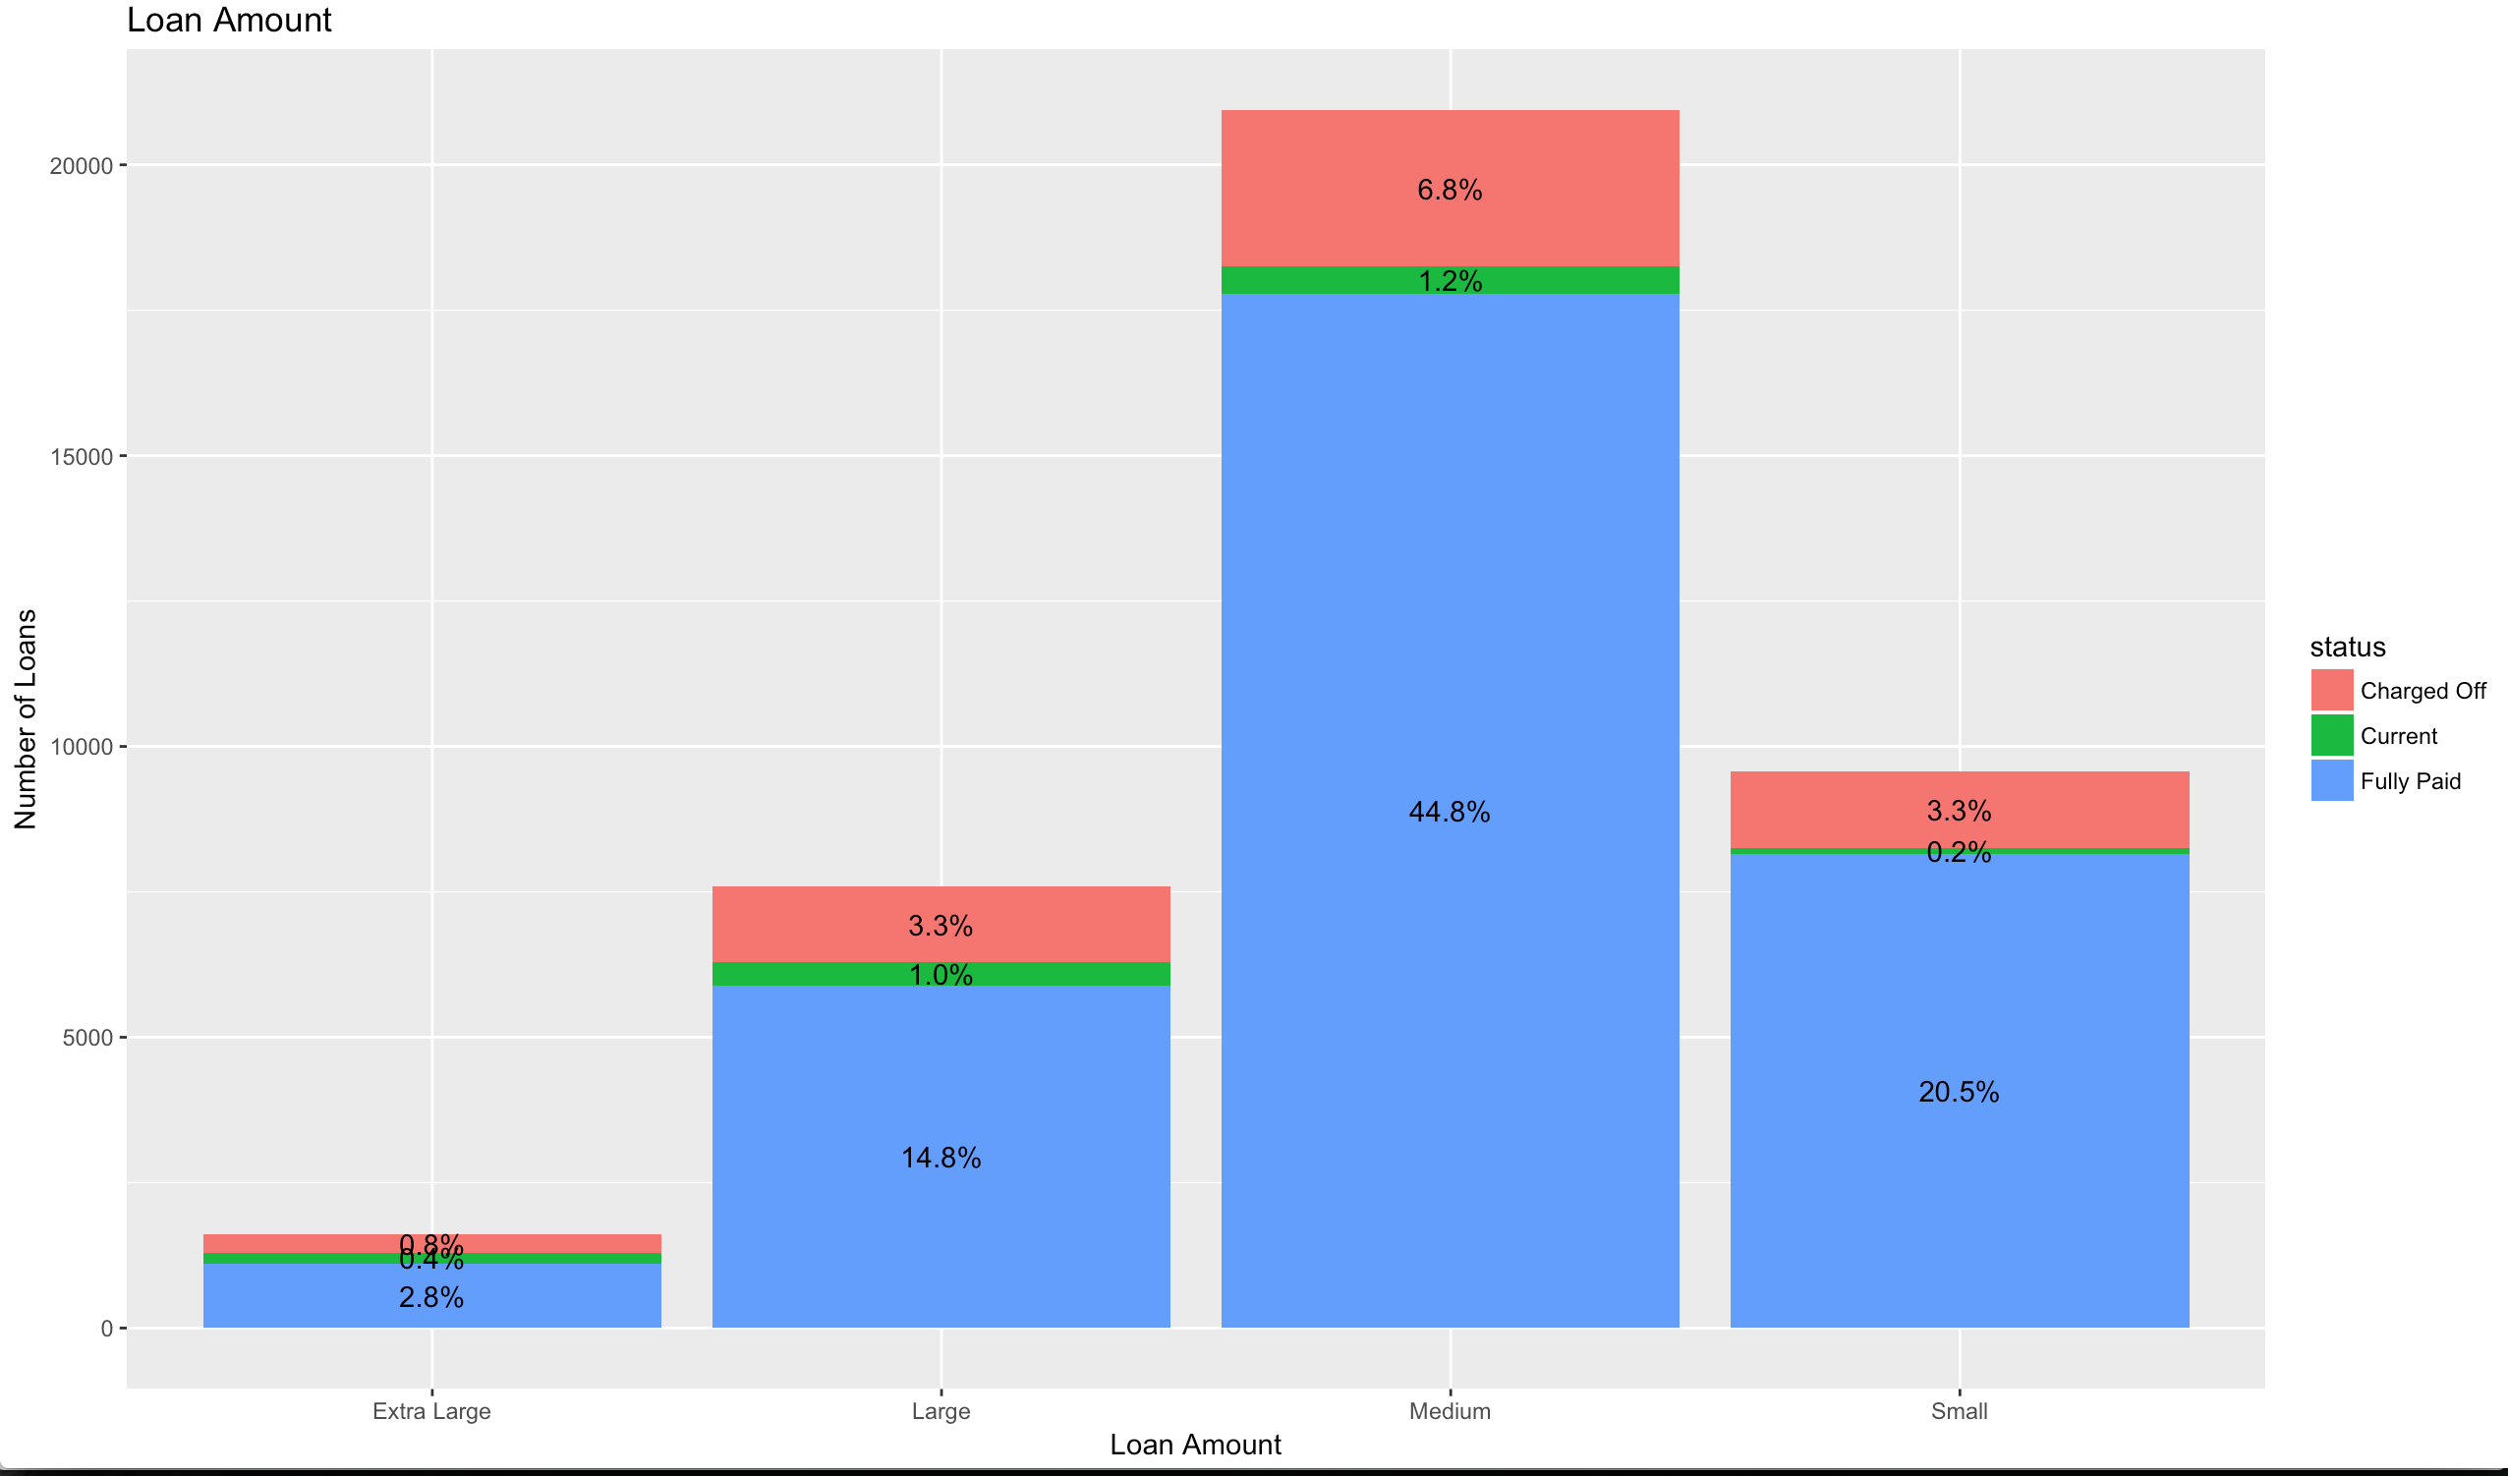
Bivariate Analysis – Amount vis-à-vis Status
More that 50% of the loan amounts were between $5000 and $15000 i.e Medium group
Nearly 7% of the customers in the medium loan group defaulted
There is a positive relationship between the two variables
As the loan amount increases there is tendency for customers to default

Slide 14
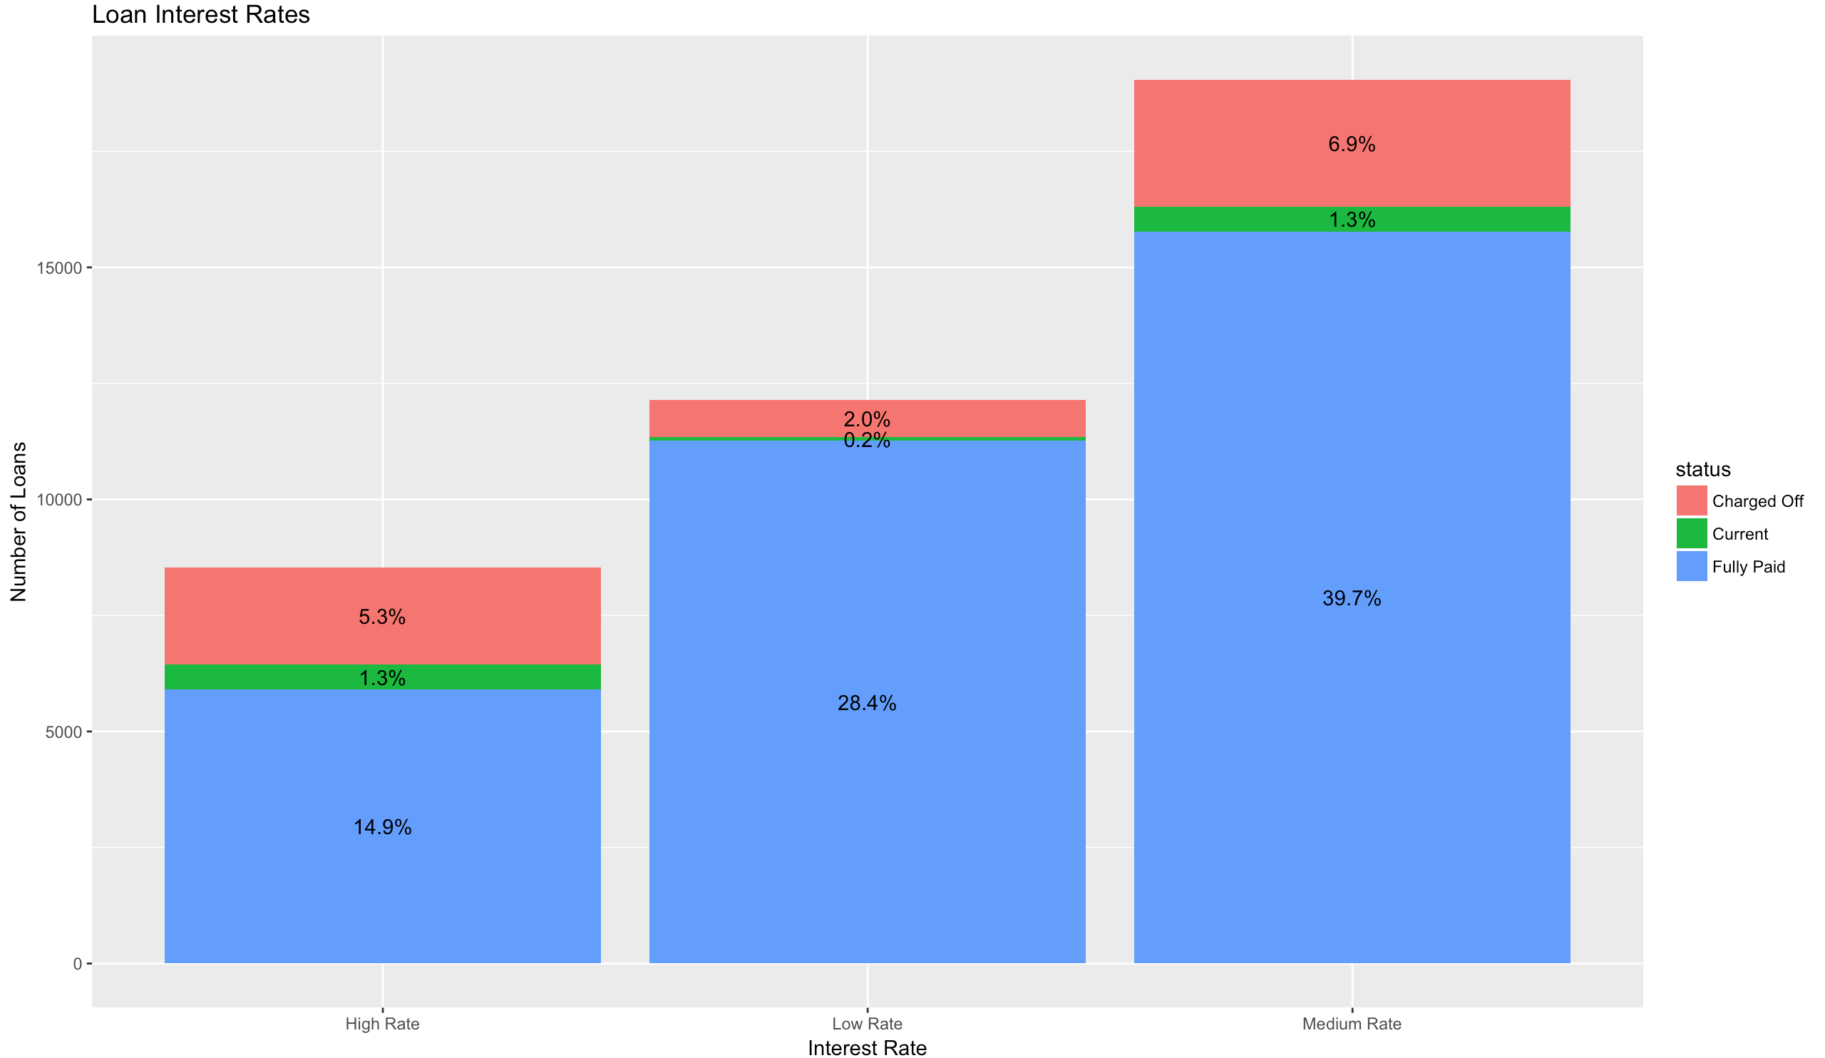
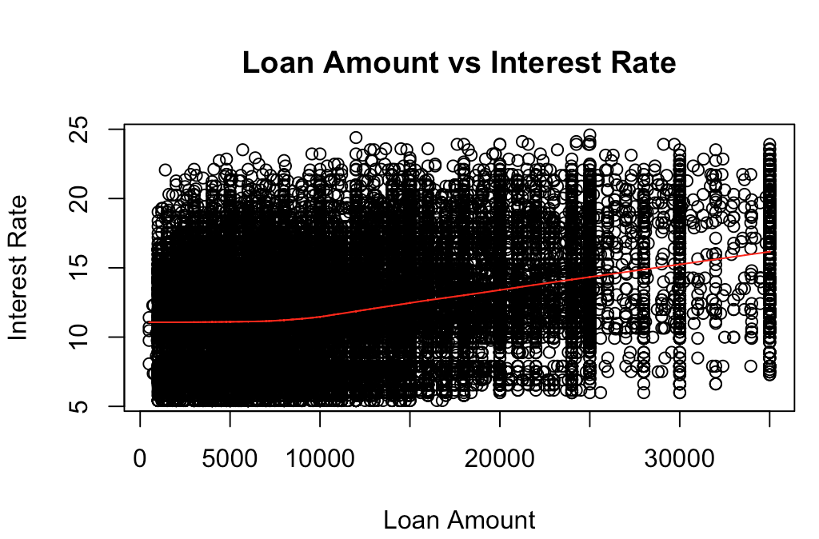
Bivariate Analysis – Interest Rate vis-à-vis Status
Nearly 48% of customers have a medium loan rate i.e between 10% and 15% interest rate
Only 2% of customers with low interest rate i.e below 10% defaulted on their loans
Default rate is highest (6.9%) when loan rate is medium
Around 20% of customers were on a high loan rate i.e above 15%.
Nearly 5% of the high loan rate payers defaulted
When Loan amount increases after $5000 the interest rate increases steadily

Slide 15
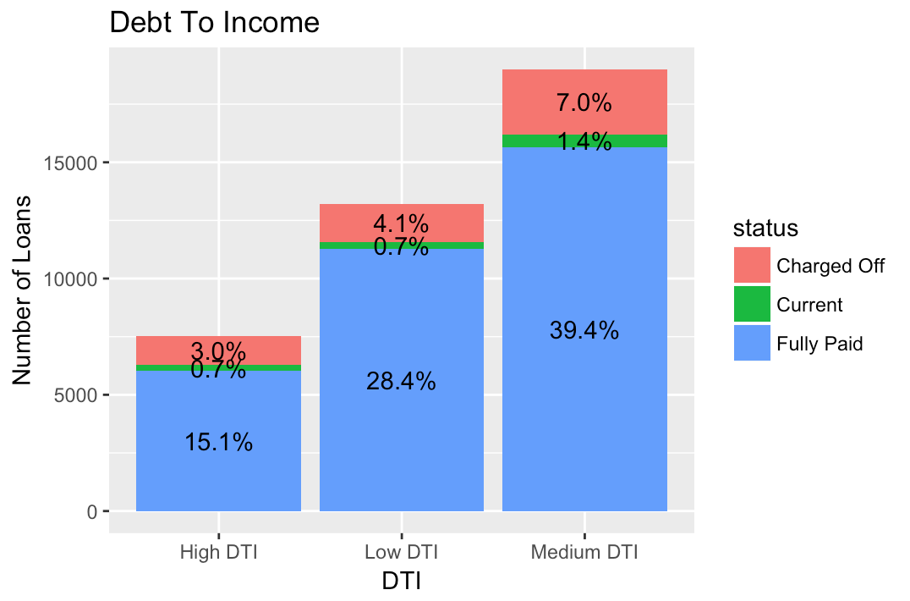
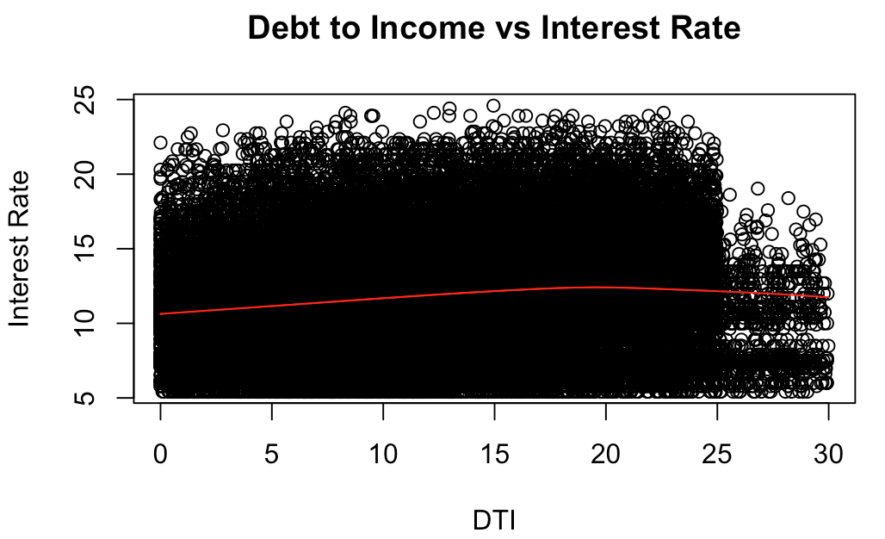
Bivariate Analysis – DTI vis-à-vis Status
Nearly 48% of loans had Medium (>=10 and <20) DTI percentage. Around 7% of these defaulted on their loans
Only 3% of people with a High (>=20) DTI percentage defaulted on their loans
When the DTI of a customer increases then the loan rate tends to marginally increase

Slide 16
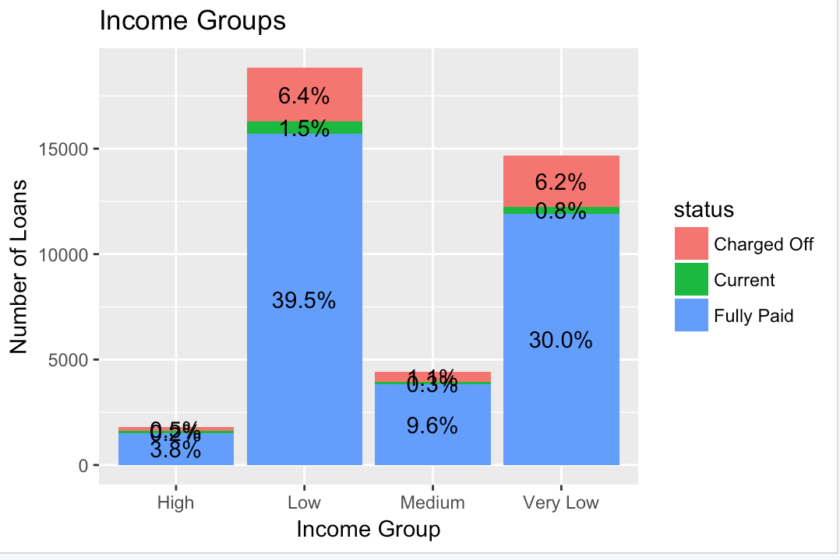
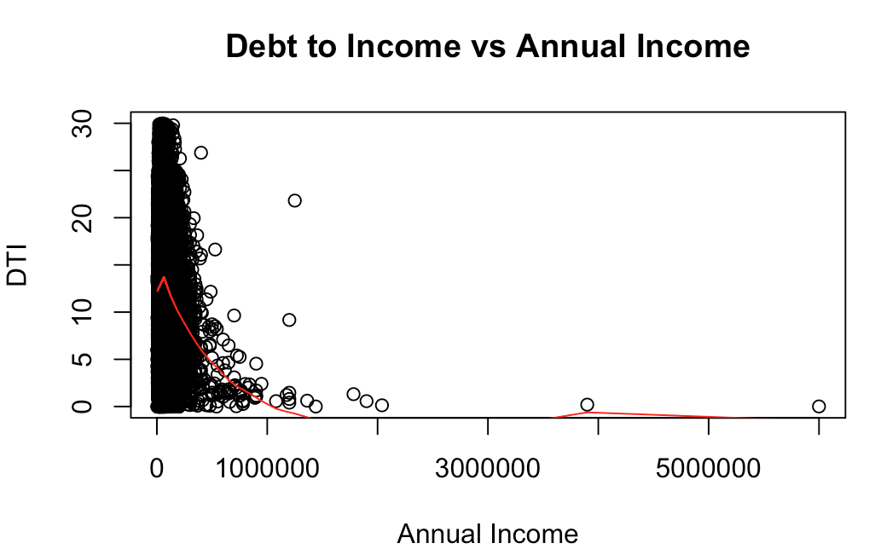
Bivariate Analysis – Annual Inc vis-à-vis Status
84% of the borrowers were in very low and low income groups
Default rate was 6% in both very and low income groups
Risk of default is high in very low and low income groups and low in High income group
When annual income increases the debt to income tends to decrease

Slide 17
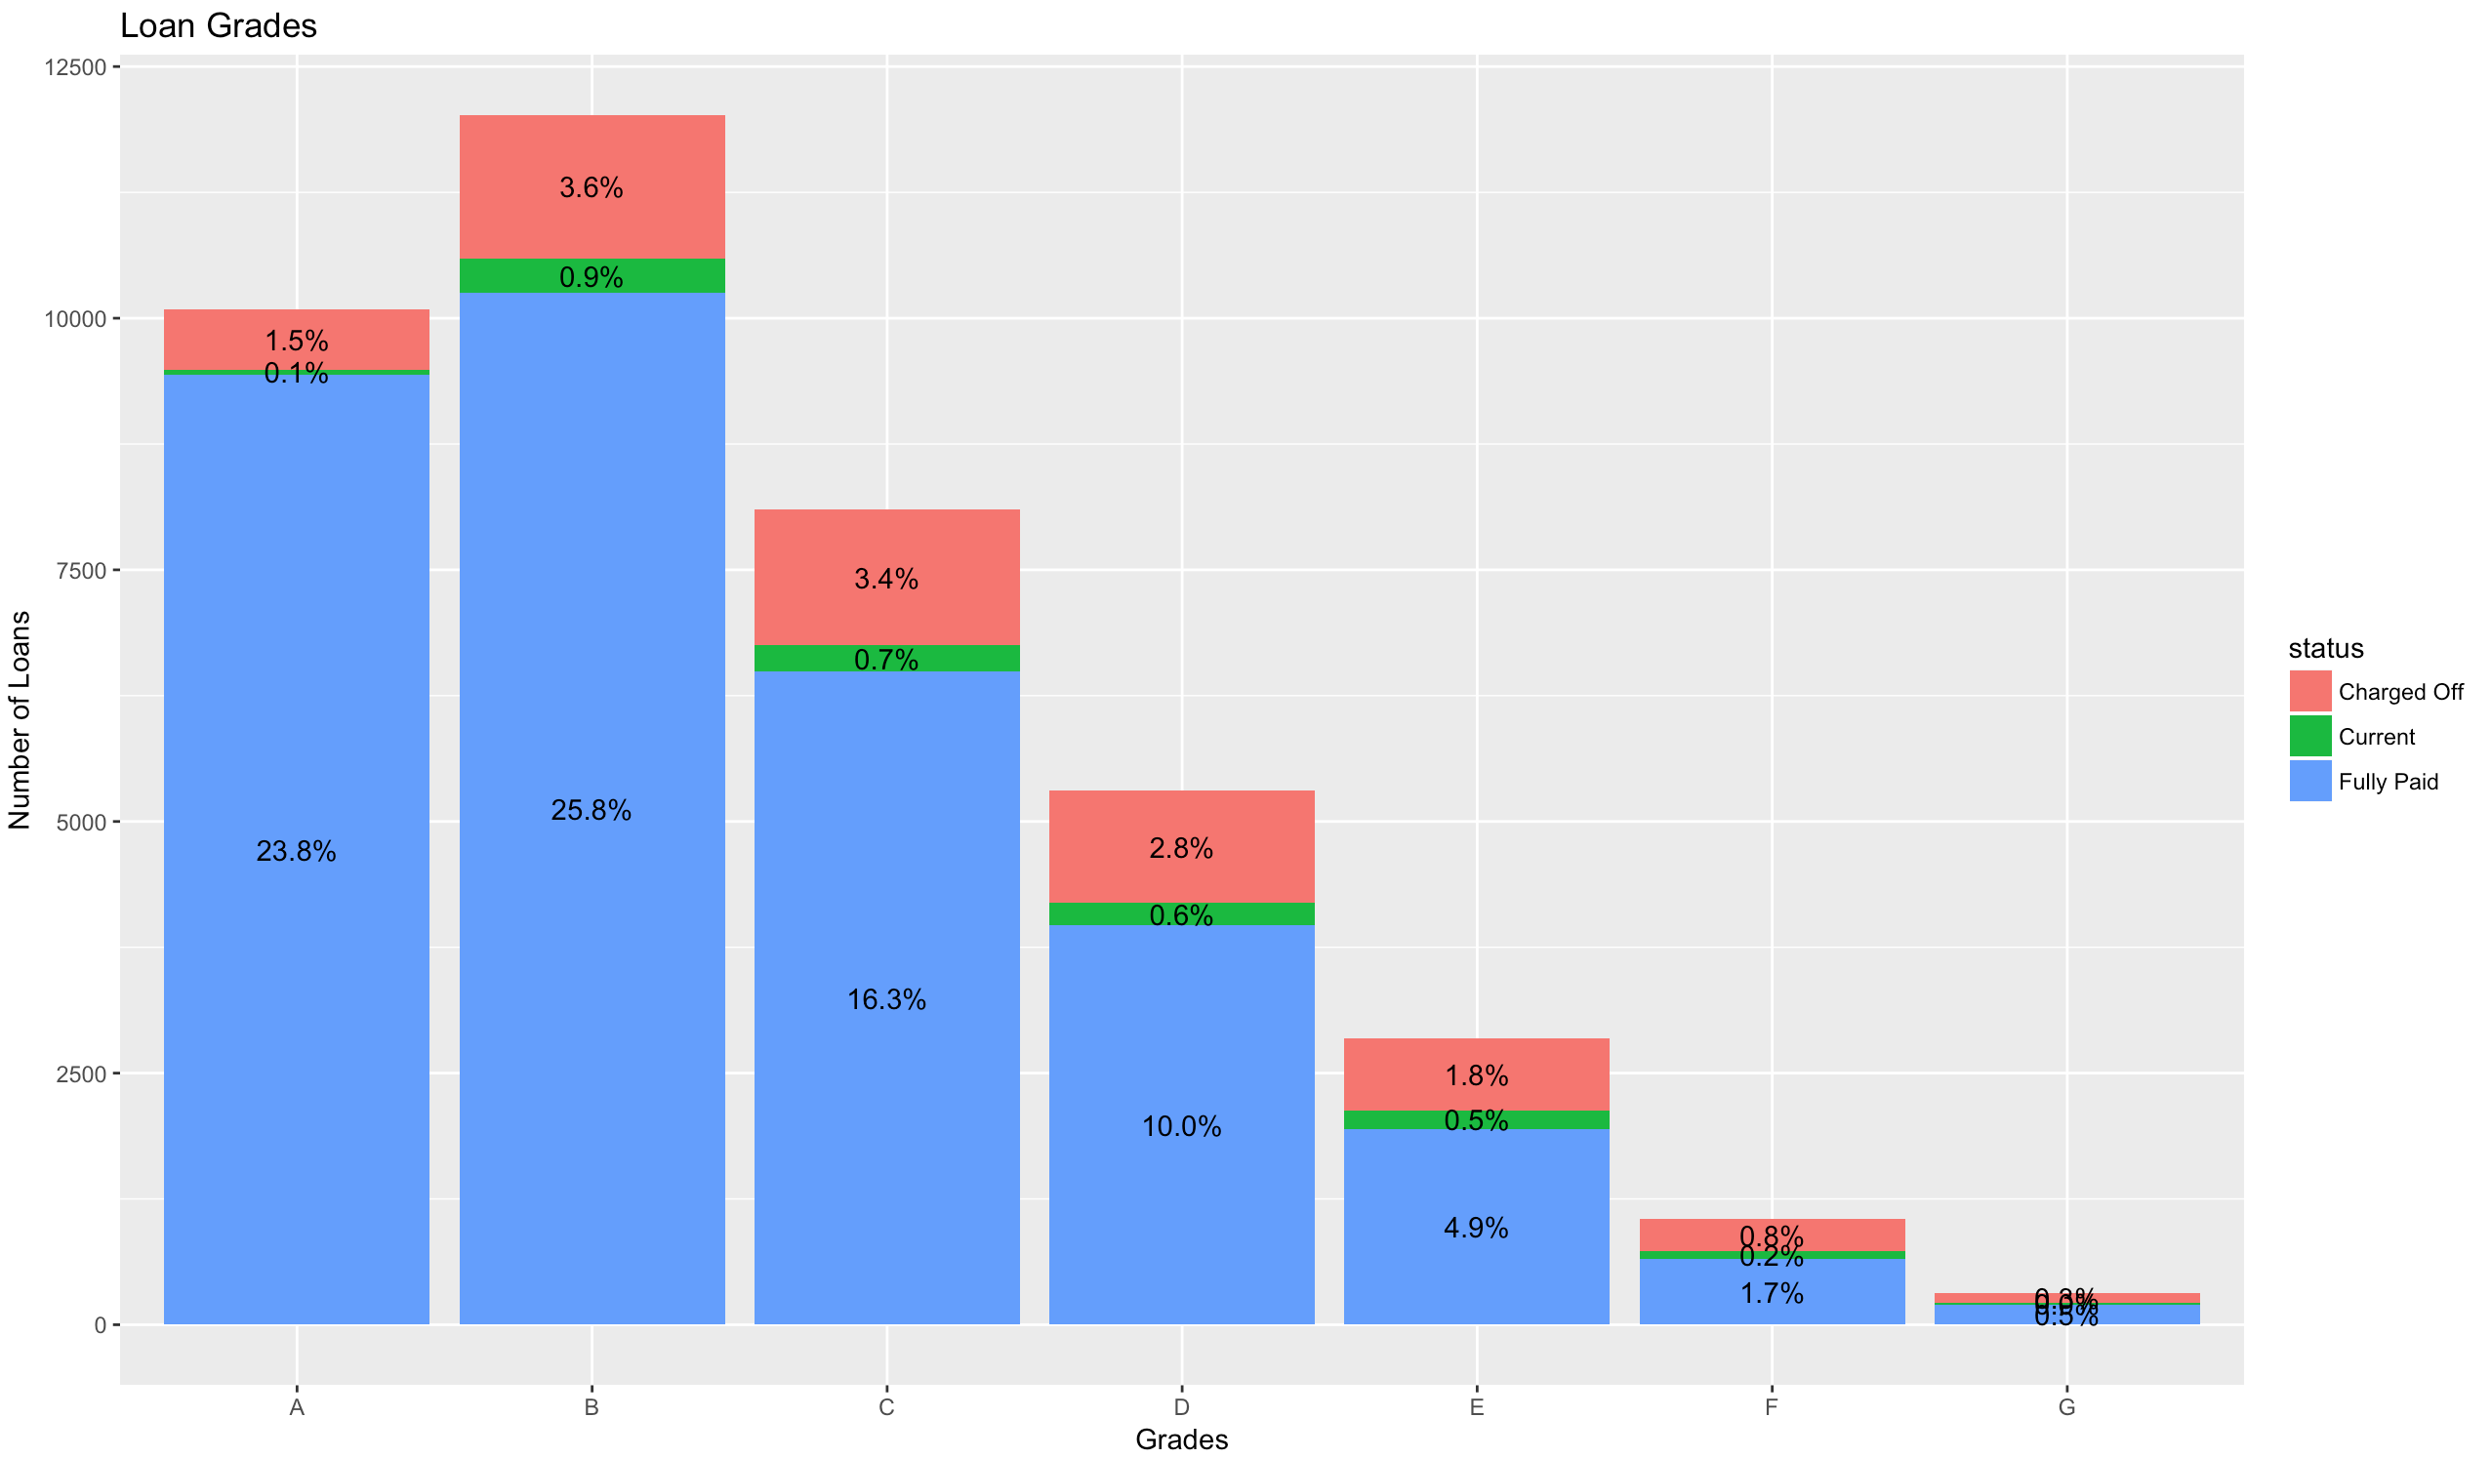
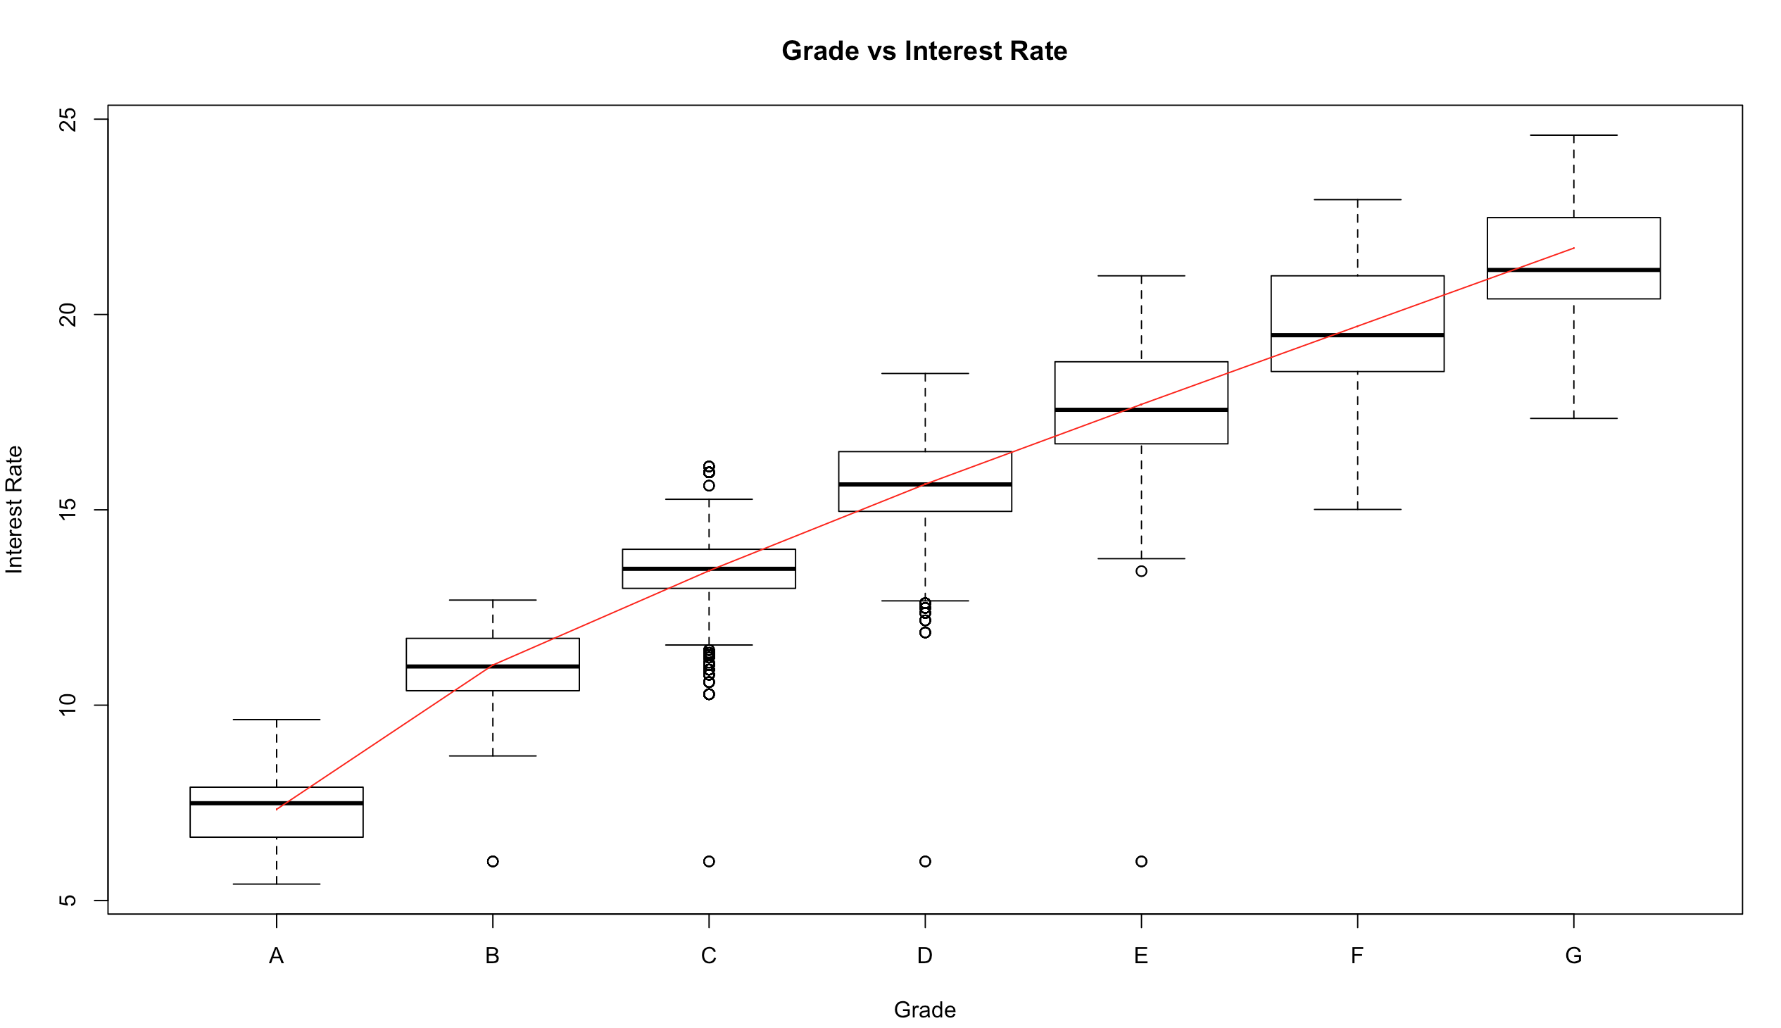
Bivariate Analysis – Grade vis-à-vis Status
Maximum number of loans were in grade B, which accounts to 31% of all loans
Most number of defaults were in Grades B and C
When loan grade decreases interest rate increases steeply
Default risk increases as loan grade decreases

Slide 18
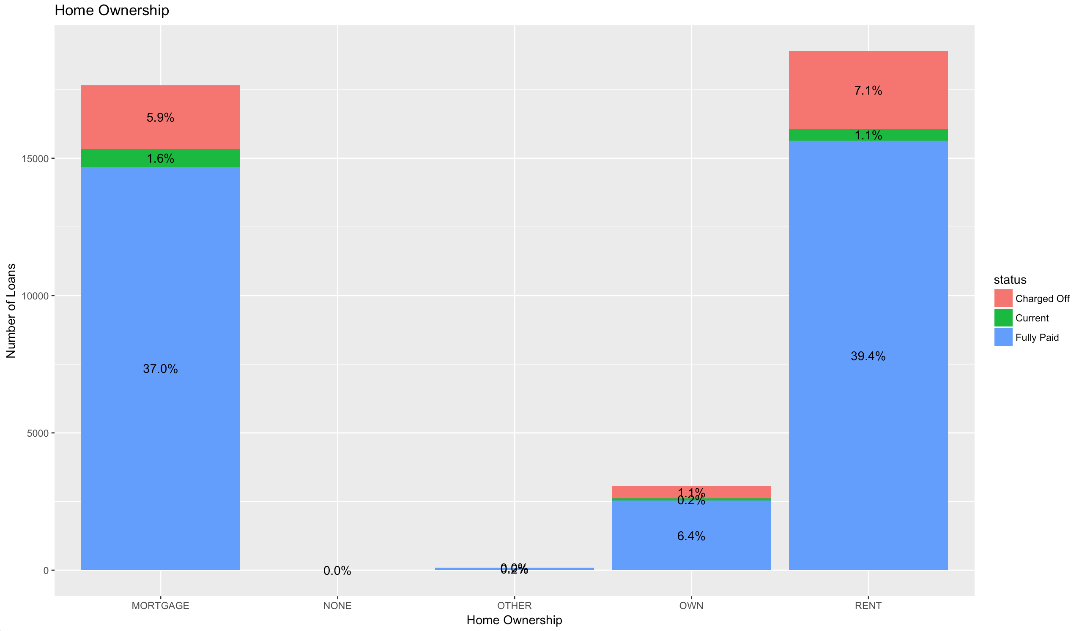
Bivariate Analysis – Home vis-à-vis Status
47.6% of loan applicants lived in rental homes and 7.1% of these customers defaulted
44.5% of customers were currently paying mortgage and out of which 5.9% defaulted on their loans
Only 1.1% of customers who owned their property defaulted on their loans
Customers living on rent or paying mortgages have more tendency to default than people who own a property
If customers are owners of a property then the chance of defaulting decreases

Slide 19
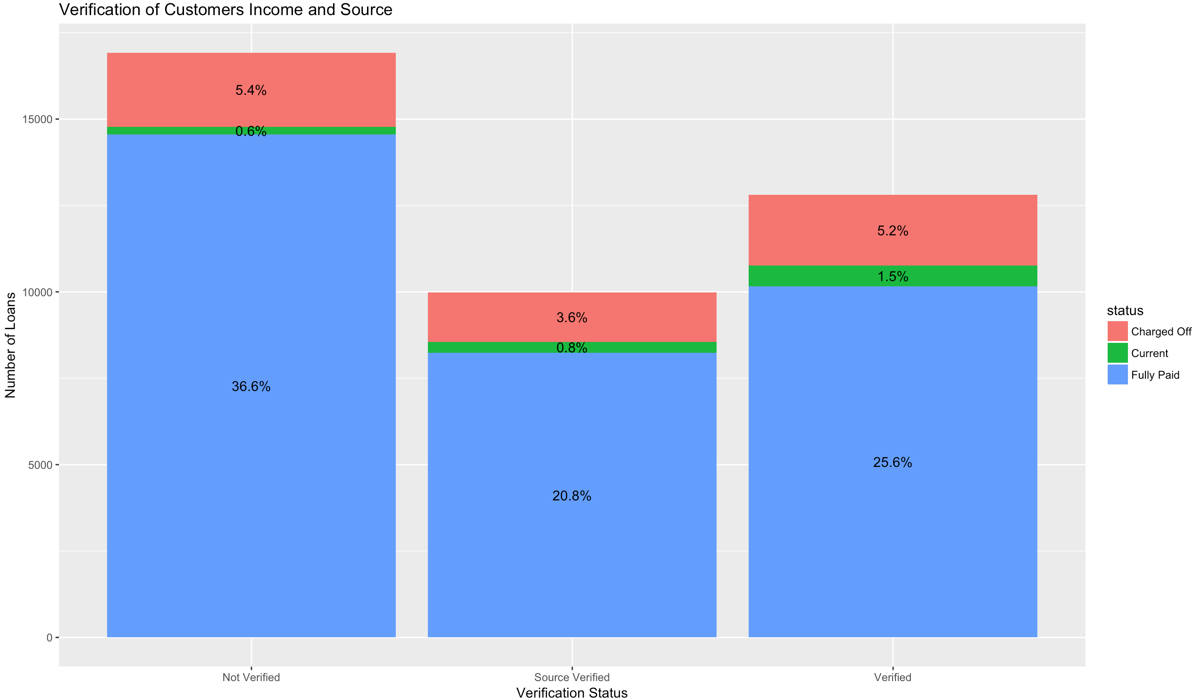
Bivariate Analysis – Verification vis-à-vis Status
5.4% Defaulted when customer's income was not verified
Low default rate of 3.6% when the customer's source of income was verified

Slide 20
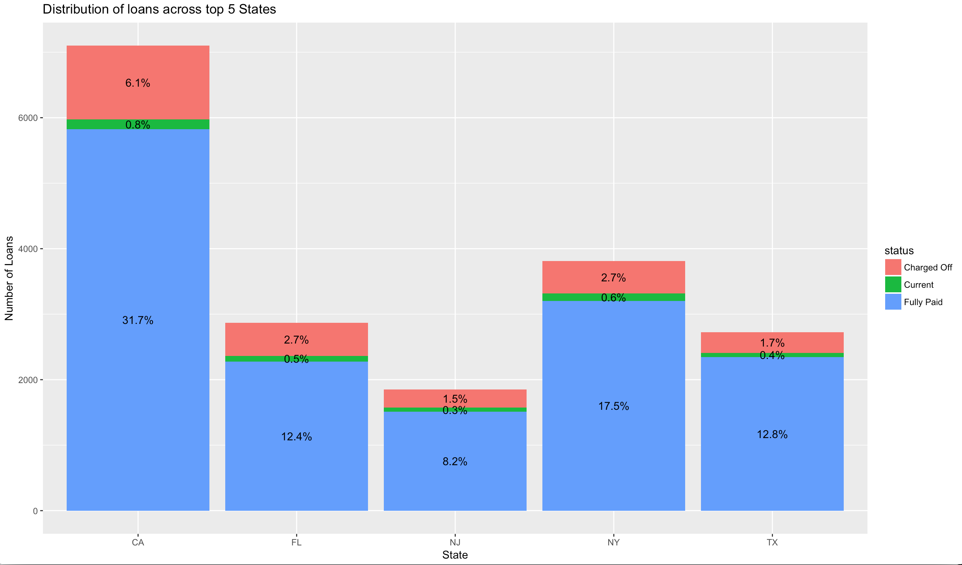
Bivariate Analysis – State vis-à-vis Status
Top 5 states for loan applications were CA, NY, FL, TX and NJ
CA had the most defaulters of 6.1% followed by NY of 2.7% and FL of 2.7%

Slide 21
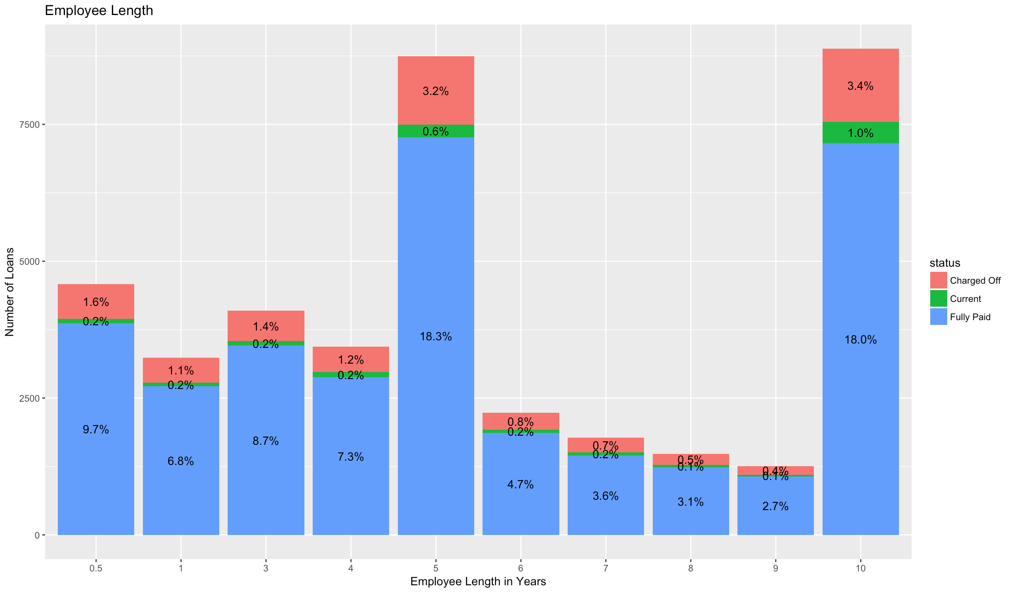
Bivariate Analysis – Emp Length vis-à-vis Status
Employee length was below 5 years for 50% of loans
22% of loans were taken by customers who had over 10 years of experience
There is a higher tendency to default on the loans when employees length of work is less than 5 years

Slide 22
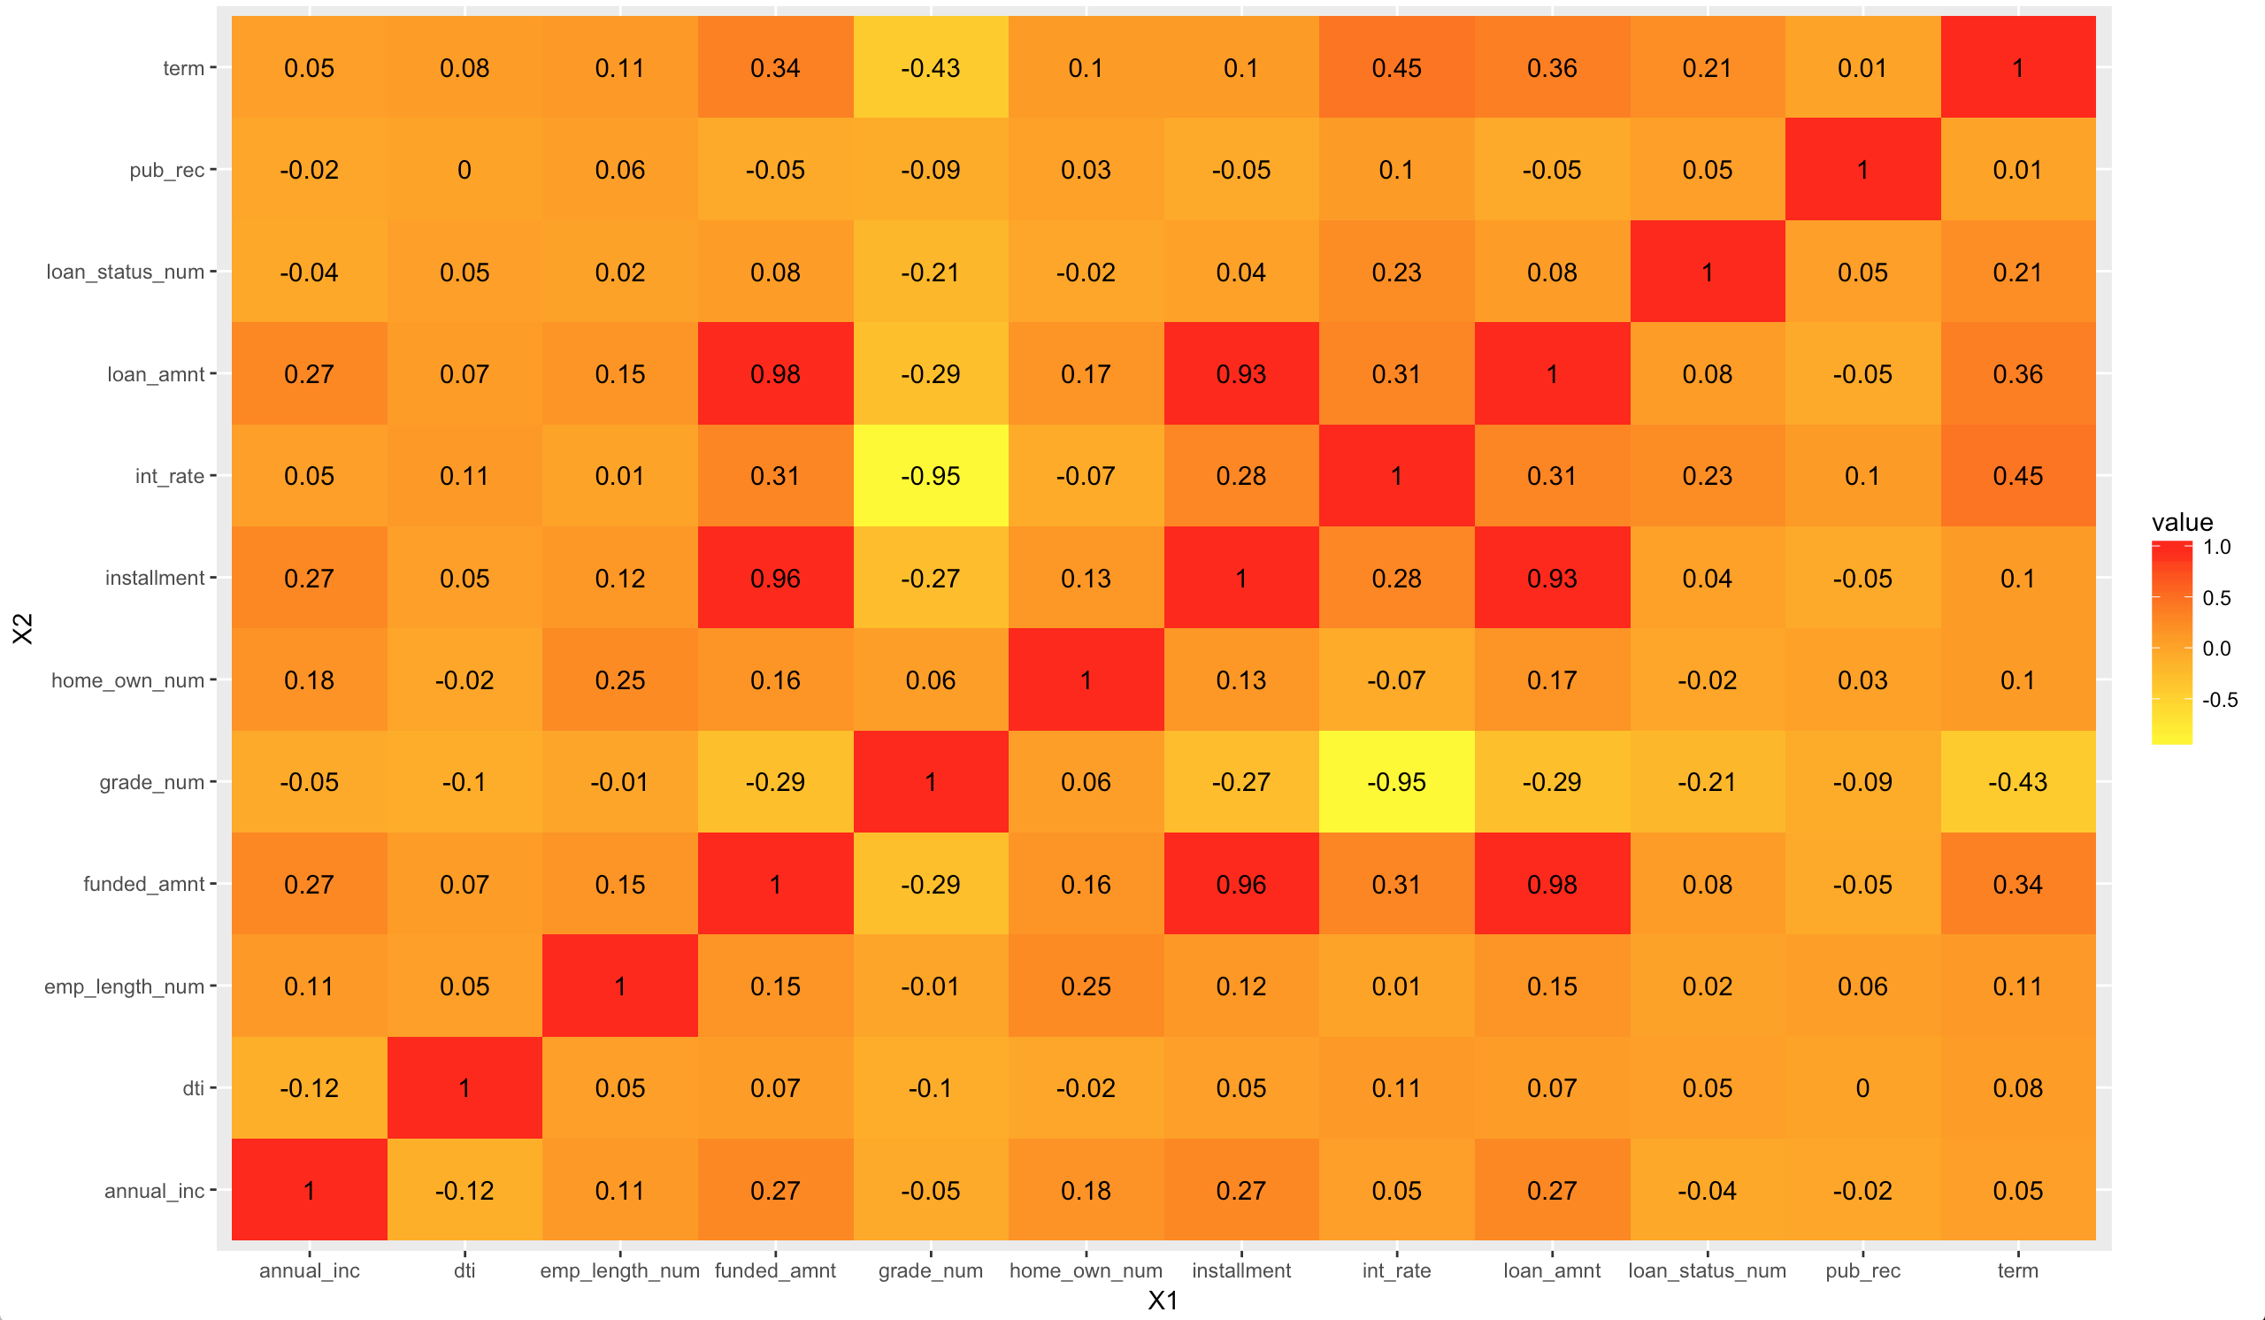
Multi-Variate Analysis – Heat Map

Slide 23
Key Observations From Heat Map
Risk of default increases when Interest Rate on the loan increases
Tendency to default on a loan increases when the loan Term increases
When loan Grade decreases then the potential to default on the loan increases
Higher loan amounts are riskier and increase the chances of default
Customers with a higher Debt To Income percentage are more riskier
Customers with derogatory Public Records are more riskier
Customers with a low or very low Annual Income have a higher tendency to default
Customers who own their Home have a lesser tendency to default compared to living on Rent or paying Mortgage
Customers with a low employment length have a higher tendency to default

Slide 24
Significant Customer Attributes
Analysis of Consumer attributes from the data has highlighted the following attributes that are key drivers for default.
Key Customer attributes for Loan Default are:
 | Relationship with Loan Default | Effect of variable on Loan Status
Debt To Income | +0.05 | Higher the DTI more riskier the customer becomes
Public Record | +0.05 | A customer with derogatory public record has a higher chance of defaulting
Annual Income | -0.04 | Customer with a high annual income tends to be less riskier
Employee Length | +0.02 | Customer with a low employee length tends to be more riskier
Home Ownership | -0.02 | Home owners are less riskier then living on rent or paying mortgage

Slide 25
Significant Loan Attributes
Analysis of Loan attributes from the data has highlighted the following attributes that are significant drivers for default.
Key Loan attributes for Loan Default are:
 | Relationship with Loan Default | Effect of variable on Loan Status
Interest Rate | +0.23 | Higher interest rates increases the chances of default
Term | +0.21 | Longer the term higher the chances are of default
Grade | -0.21 | Lower grade loans have a higher chance of default
Loan Amount | +0.08 | Higher the loan amount higher the chances of default
Installment | +0.04 | Higher the installment amount higher the chances of default

Slide 26
Conclusions
Analysis of consumer and loan attributes that influence the tendency to default was carried out. Top 5 variables which are strong indicators of default were identified.
Following conclusions have been reached,
Key Loan attributes are Interest Rate, Term and Grade
Key Customer attributes are Public Record, DTI and Annual Income
Key driver attributes for Loan Default are:
Interest Rate
Term
Grade
Public Record
Annual Income

Slide 27
Recommendations
Company will benefit from considering the following strategy when approving a loan application. The proposed strategy is based on the most important customer and loan attributes that have a significant influence on loan default.
Recommended Strategy
A loan has a higher rate of default when the following conditions are met.
Interest rate is greater that 10 and
Term is greater than 36 months and
Grade is lower than B and
When customer has a derogatory Public Record and
Annual Income of the customer is lesser than $10000 and
DTI is greater than 10

